Slide 1

Adventure Works Sales Analysis Report For Executive Leadership.
This report analyzes Adventure Works sales data, providing insights into revenue trends, product performance, and regional sales patterns.
Paul Lemaron
Turing College- DA

Slide 2
Problem Statement
1
What is the Overall Sales Overview over the years?
Understanding the different sources of revenue, and revenue generation over the
Years..
2
What are the product sales trends?
Revenue generation by product categories, and subcategories.
3
What is the sales trends per region?
Analysis of the revenue and profits generation by year, the sales sources distribution
By regions, Total products quantity per region

Slide 3
Sales Overview
Key Performance Indicators
Total Orders | Total Revenue | Profit | % Profit
31465 | $140,707, 584 | $9,371, 821 | 9.33%

Slide 4
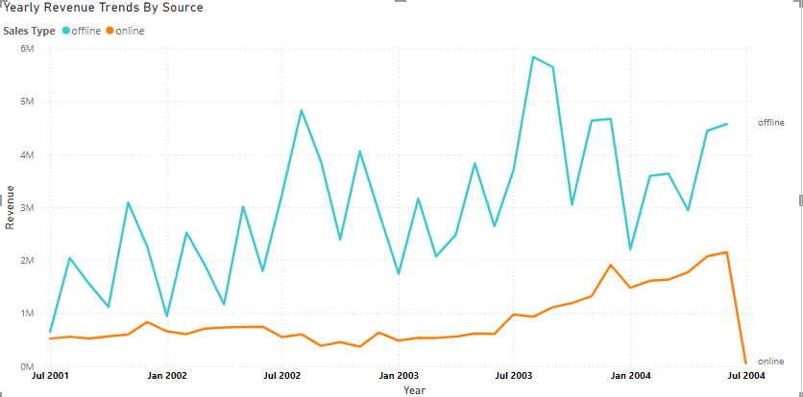
Sales Overview
Sales Channels & Revenue Generation
1
Offline Sales
Offline sells demonstrated an unsteady but progressive
Rise over the years while generating $5.8M at the highest
In July 2003.
2
Online Sales
Revenue decreased significantly between 2001 and 2004.
3
Revenue Trend
Online sales started trending upwards in July 2003.
Notes:
Overall Sales Trends:
Total revenue amounted to $140,707,584 with a profit of $9,371,821, representing a 9.33% profit margin.
Offline sales have shown a progressive increase, peaking at $5.8M in July 2003, while online sales experienced fluctuations, showing a significant upward trend from mid-2003 onwards.

Slide 5
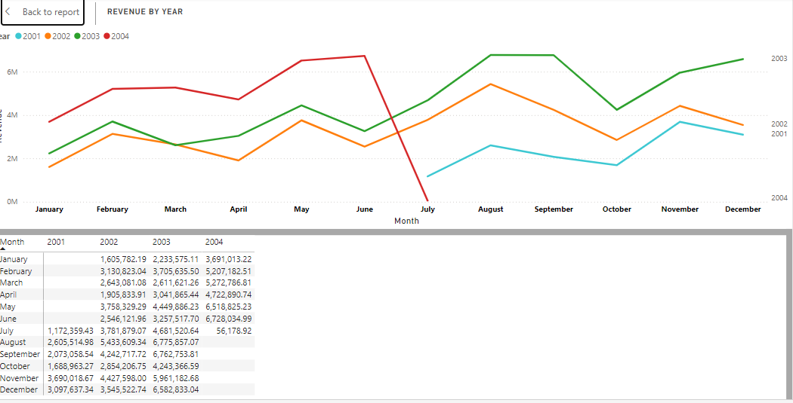
Sales Overview
Yearly Revenue
Highest Revenue
Revenue Distribution
FY2002 | FY2003 | FY2004 | Total Revenue
$29, 917, 523 | $43,585,635 | $67,148,244 | $140,707, 584
August 2003 contributed 4.82% of total revenue.
Best Sales Month always trends highest in August.
2004 had the highest
total revenue.
Notes:
Yearly Performance:
FY2004 generated the highest revenue at $67,148,244.
August consistently recorded the highest sales contribution across years, with August 2003 alone accounting for 4.82% of total revenue

Slide 6
Products Overview
Yearly Revenue
No. Of Products | Products Categories | Products Sub-categories | Avg Revenue/product
266 | 4 | 35 | $ 35, 232

Slide 7
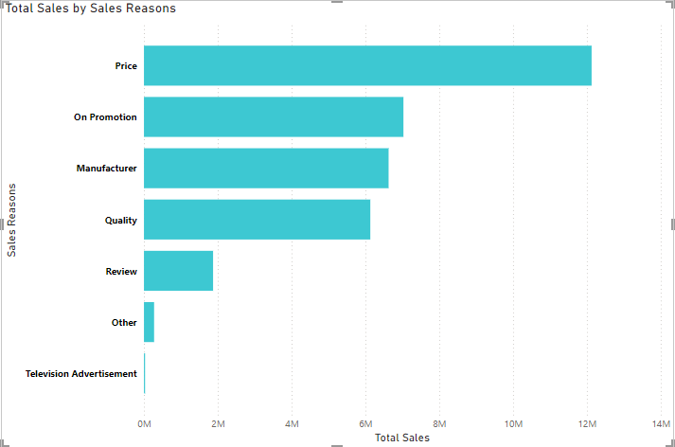
Sales Reasons Analysis
1
Highest Total Sales
Price had the highest total sales.
2
Sales Range
Total sales ranged from $ 30,360.81 to
$ 12,128,306.44.
3
Price Contribution
Price accounted for 35.57% of total sales.
Notes:
Top Sales Drivers:
Pricing emerged as the top factor, contributing 35.57% of sales revenue.
Sales ranged between $30,360.81 and $12,128,306.44, showing significant disparities in product performance.

Slide 8
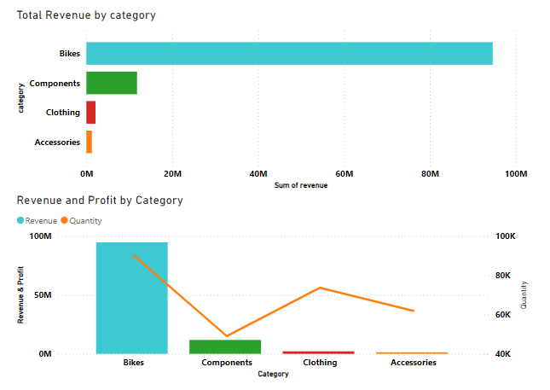
Product Performance
Category
Revenue
Quantity
Bikes
$94,651,172.71
90,268
Components
$11,802, 593
49,044
Clothing
$ 2,120,542
73,670
Accessories
$ 1,272,072.89
61,932
Notes:
Product Performance:
Bikes dominated revenue generation ($94.65M), with road bikes leading at over $40M.
Accessories like helmets and tires performed best within their category, contributing 42% and 21% of accessory revenue, respectively.
Top-selling product: "Mountain-200 Black, 38" at 7.19% of total bike sales

Slide 9
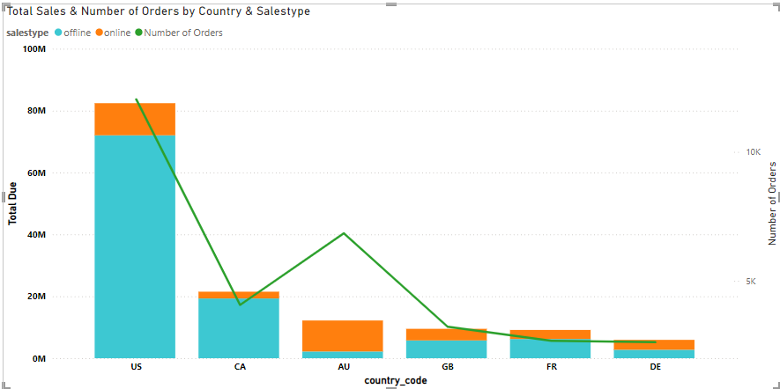



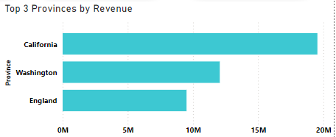

Regional Sales Analysis
Total Due
Offline sales had higher total due than online.
USA Contribution
USA offline sales contributed 51.21% of total due.
Average Total Due
Offline sales had higher average total due than online.
Top 3 Provinces
California had the highest revenue, followed by
Washington and England.
Notes:
Regional Sales Analysis:
Offline sales contributed 51.21% of total dues, with the USA leading geographically.
Top provinces by revenue: California, Washington, and England.
Offline channels exhibited higher average total dues compared to online.

Slide 10
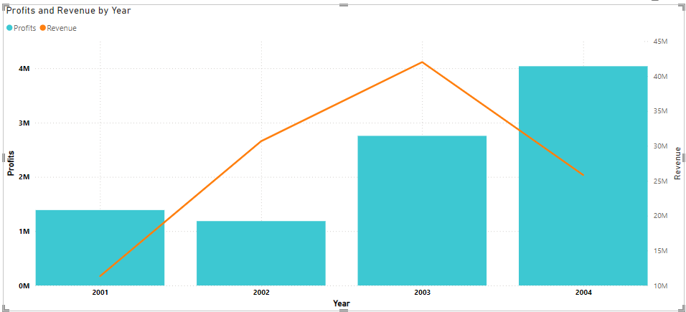
Regionals Overview
Countries | Provinces | Avg Revenue/Country | Avg Revenue/province
6 | 70 | $23.45M | $ 2.01M

Slide 11
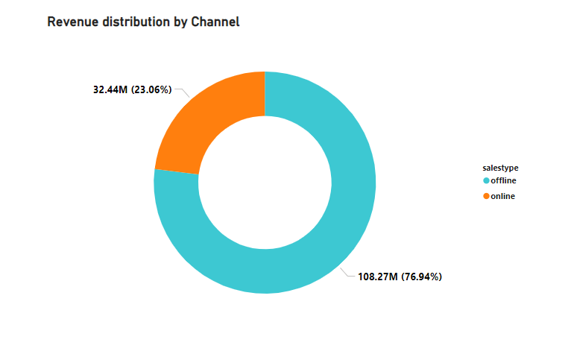


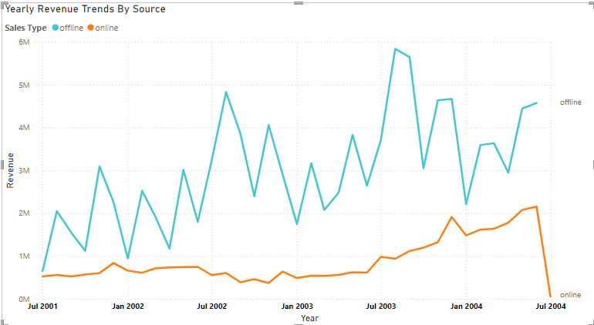
Sales Channel Analysis
Offline Sales
Online Sales
Offline sales had a significant impact on total revenue.
Online sales contributed to a smaller portion of total revenue but continues to show a steady rise over the years.

Slide 12
Recommendations
Boost Online Sales: Invest in online channels as they show potential of growth from $484,946 to an all-time high of $2.1M sales.
Focus on High Performers: Prioritize bikes and top accessories like helmets.
Optimize Pricing: Implement dynamic and competitive pricing models.
Expand Regionally: Strengthen top regions and explore underperformers.
Leverage Seasons: Prepare for peak sales in August

